Slide 1



Extending and Formatting PowerShell types
Dave Goldman

Slide 2
about _Speaker
Working at Microsoft for ~20 years (All with the Exchange Product 5.5 - 2019)
Sr. Customer Engineer / Sr. Premier Field Engineer
Mostly known for: Offline Address book and OABInteg
Module: PSServicePrincipal
Contributing to: PSFramework
Github: https://GitHub.com/dgoldman-msft
Twitter: @matrixsurfer128
LinkedIn: https://www.linkedin.com/in/dgoldman-msft/

Slide 3
topics
PowerShell objects
The PowerShell Pipeline - how objects pass through and get formatted
The formatting selection process
Extending and formatting objects in interactive PS Sessions and in modules
Debugging PowerShell core – for those that are interested ☺
Demos!!

Slide 4
Powershell objects

Slide 5
Every action you take in PowerShell occurs within the context of object.
An object is made up of different components:
Methods
Properties
Events
Metadata
Notes:
Methods – Allow you to change properties
Properties – Contain the actual values
Events – Can be subscribed to for actions
Metadata – Other information about the object, type, etc
DEMO: Object types
Get-Process | gm | s 15
Get-Job | gm | s 15

Slide 6
The Pipeline and formatting

Slide 7
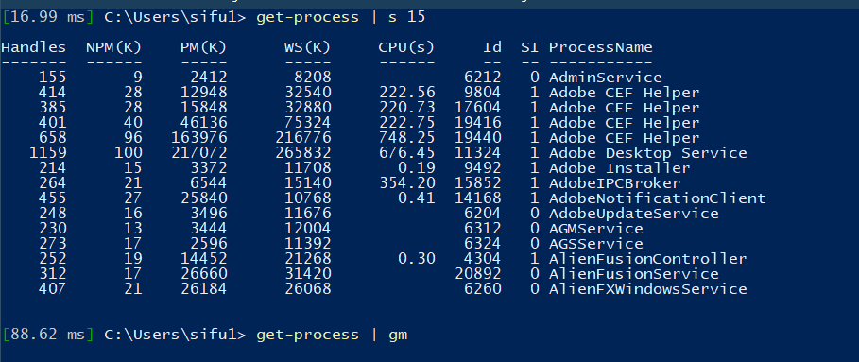
The PowerShell pipeline
PS> Get-Process | Where-Object {$_. Handles –gt 50} | Sort-Object Handles | Format-Table
PowerShell Parser
Get-Process
Where-Object
Sort-Object
Out-Default & Out-Host
PowerShell Pipeline Processor
Notes:
How are objects views
You pass a command into the pipeline (Get-Process). A System.Diagnostics.Process object is created to hold the information which is returned by the pipeline
This object will pass down the pipeline until it gets to the end of the pipeline.
When an object reached the end of the pipeline PowerShell adds Out-Default to the pipeline (in the background).
4. Out-Defaults does two things
1. Is responsible for sending output to the PowerShell formatting engine
2. Send the output to Out-Host to be displayed in the console.
Formatting system will look up and resolve the object types
1. Checks for a predefined view associated with that object type. (This is stored in the type table cache)
2. IF no predefined view them look for a user defined view backed by customer types.ps1xml and format.ps1xml files (depending on being used within a module or a PowerShell session)
3. IF no user defined view the formatter will check to see if the DefaultDisplayPropertySet is present and populated.
4. If there is no DefaultDisplayPropertySet the PowerShell formatting system will do its best to create a format for the output in a table (default option) or list if there are too many properties to display (over 4 everything goes to a list).
NOTE: $FormatEnumerationLimit – Default value of 4, and it determines how many items are displayed when a property contains more than a single item.

Slide 8
Extending and formatting objects

Slide 9
Maml xml
TYPES.ps1xml – Extend objects.
Properties
Methods
Scriptblocks
…
FORMAT.ps1xml – Define how objects are displayed.
Table
List
…
Notes:
MAML is an XML format used for PowerShell Online help
Microsoft Assistance Markup Language - MAML - https://en.wikipedia.org/wiki/Microsoft_Assistance_Markup_Language
ELABORATE on this one a little. Types.ps1xml - This file allows you to extend objects with additional properties (aliases, etc.)
Format.ps1xml - You have four different views of each object: Table, List, Wide, Custom.
The formatting affects only the display output. It doesn't affect which object properties are passed down the pipeline or how they're passed.
WARNING: You never want to update these core files because they are signed and can cause damage. What we can do is use one as a template for our custom object.
NOTE: Beginning with PowerShell 6, this information is compiled into PowerShell and is no longer shipped in a Types.ps1xml file.
DEMO: Files location: Stored in the following location: Get-ChildItem $PSHome/*type*.ps1xml

Slide 10
Procedurally
Add-Member
Update-TypeData
Update-FormatData
Notes:
Procedurally we need to know a few operations that will allow us to make these necessary modifications to update types and object
NOTE: Update-TypeData and Update-FormatData are for the interactive PowerShell session.
1. Update-TypeData reloads the types.ps1xml file into memory adding new extended data to the table cache
2. Update-FormatData reloads the formatting data into the current session. (no need for a restart of PowerShell)
NOTE: These types are included in the Microsoft.PowerShell.Utility module.
DEMO: Custom object creation – Interactive PowerShell session
Create myCustomObject
Show members with –force
Show how to Add-Member LastName will allow me to add a property to an existing object – Inserted at the bottom on purpose
Show the PSCustom object pstypenames
Show Update-TypeData
Show Update-Format
Show data still exists
DEMO: Show how it works in a module
Show the psd1 file references
Show the xml files Job format creation – PowerShell module

Slide 11
Pipeline order of operation
You pass a command into the pipeline (Get-Process). A System.Diagnostics.Process object is created
This object will pass down the pipeline until it gets to the end of the pipeline. When an object reached the end of the pipeline PowerShell adds Out-Default to the pipeline (in the background).
Out-Default will hand off the object to Out-Host.
Out-Host will interact with the PowerShell formatting engine.
PowerShell formatting system will look up and resolve the object type to see if there is a predefined view associated with that object type. (This is stored in the type table cache)
IF NOT then the PowerShell formatting system will look to see if there is a user defined view with-in the types.ps1xml and format.ps1xml file (depending on being used within a module or a PowerShell session)
IF NOT the formatter will check the object next to see if the DefaultDisplayPropertySet is present. If there is no DefaultDisplayPropertySet
NOTE: For any object in PowerShell, you can access its PSStandardMembers.DefaultDisplayPropertySet property to see the properties that are default for that object, if they are defined.
IF NOT the PowerShell formatting system will do its best to create a format for the output in a table (default option) or list if there are too many properties to display (over 5 everything goes to a list).

Slide 12
Debugging breakpoints for powershell core
PowerShell GitHub code: https://github.com/PowerShell/PowerShell
FormatViewManager.cs:
Lines 108, 117, 136, 416, 432
BaseCommand.cs:
Line 178
MshObjectUtil.cs:
Line 389
Also do a project search for:
DefaultDisplayPropertySet

Slide 13
resources
Project Files: https://github.com/dgoldman-msft/PSUtilities
PowerShell Help Files
https://docs.microsoft.com/en-us/powershell/module/microsoft.powershell.core/about/about_objects?view=powershell-7
https://docs.microsoft.com/en-us/powershell/module/microsoft.powershell.core/about/about_pipelines?view=powershell-7
https://docs.microsoft.com/en-us/powershell/module/microsoft.powershell.core/about/about_format.ps1xml?view=powershell-7
https://docs.microsoft.com/en-us/powershell/module/microsoft.powershell.core/about/about_types.ps1xml?view=powershell-7
PSFramework Website: PSFramework.org and PowerShellGallery download

